Slide 1

Behaviour-Driven Development with StoryQ Liam McLennan Freelance Web Developer
liam.mclennan@gmail.com hackingon.net @liammclennan

Slide 2
Testing / Quality Assurance
The three ways to maintain release quality:
Automatic testing of all features ever implemented
Manual testing of all features ever implemented
Customer testing of features as they encounter them in production

Slide 3
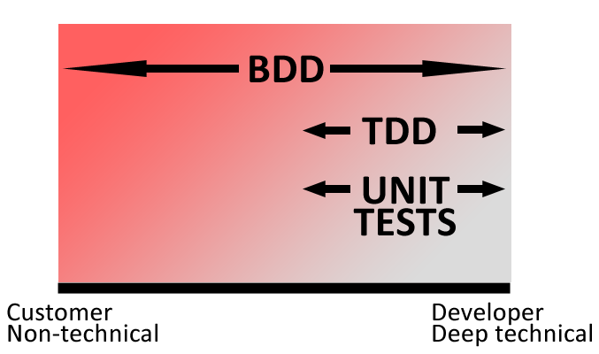
Some Automated Testing Strategies
Unit Tests / Test After
Test First (TDD)
Behaviour-Driven Development
Notes:
Unit test = Implementation verification
TDD = linking verification and design
BDD = linking verification and requirements

Slide 4
Behaviour-Driven Development Workflow
Write the user stories that define the features of the application
For each story list the behaviours of the application in the context / specification style (arrange, act, assert)
Implement the specifications until everything is passing
Notes:
BDD is outside in.

Slide 5
A String Hasher
User Story: Generate a hash of a string In order to reliably generate a consistent short representation of some text As an application user I want to generate a hash of a string

Slide 6
Scenario: Generate a hash of a string
given a string "cellar door”
when the hash is generated
then the hash is 32 characters long
and the hash is not equal to the input string

Slide 7
Scenario: Generate a hash repeatably
Given a string "A man is rich in proportion to the
number of things he can afford to let alone."
When a hash is generated twice
Then the first result is equal to the second result

Slide 8
Scenario: Generate different hashes
Given the strings "cellar door" and "A man is rich in proportion to the number of things he can afford to let alone."
When a hash is generated for each string
Then the first result is not equal to the second result

Slide 9
StoryQ
http://storyq.codeplex.com/

Slide 10
Meet the competition
MSPec http://github.com/machine/machine.specifications
Specflow http://www.specflow.org/

